Slide 1
Pricing American Options
This project prices American options of Tesla using the Binomial Tree methodology
Financial Engineering – 620 (Pricing & Hedging)
Fall 2021
Riley Heiman, Saboura Salari Rad,
Anantha Balineni, Moksh Ajmera

Slide 2
Agenda
Data Collection & Market Parameters
Model Development
Model Deployment
Delta Hedge

Slide 3
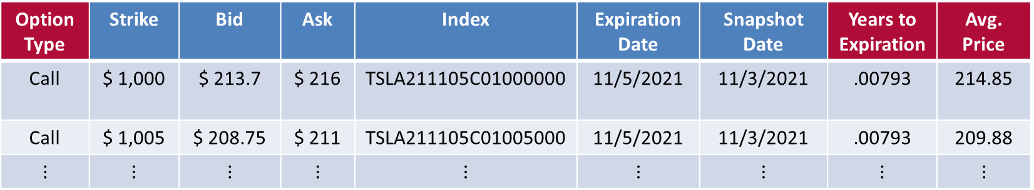
Equities & Options Data
Data Collection & Analysis
Tesla Equities Data
~4 years (01/02/2018 – 11/03/2021)
Daily stock prices. 958 trading days.
Tesla Option Chain
Variety of Strikes
$5 increments ranging from $50 to $2,175
7 Expiration Dates (11/5/2021, 11/12/2021 , … , 12/17/2021)
Sample R Code to implement quantmod package
Teslaoption = getOptionChain("TSLA" ,src = "yahoo" , "2020/2021")
Blue cells are from quantmod API
Red cells are derived columns
Option Type | Strike | Bid | Ask | Index | Expiration Date | Snapshot Date | Years to Expiration | Avg. Price
Call | $ 1,000 | $ 213.7 | $ 216 | TSLA211105C01000000 | 11/5/2021 | 11/3/2021 | .00793 | 214.85
Call | $ 1,005 | $ 208.75 | $ 211 | TSLA211105C01005000 | 11/5/2021 | 11/3/2021 | .00793 | 209.88
$$⋮$$ | $$⋮$$ | $$⋮$$ | $$⋮$$ | $$⋮$$ | $$⋮$$ | $$⋮$$ | $$⋮$$ | $$⋮$$

Slide 4
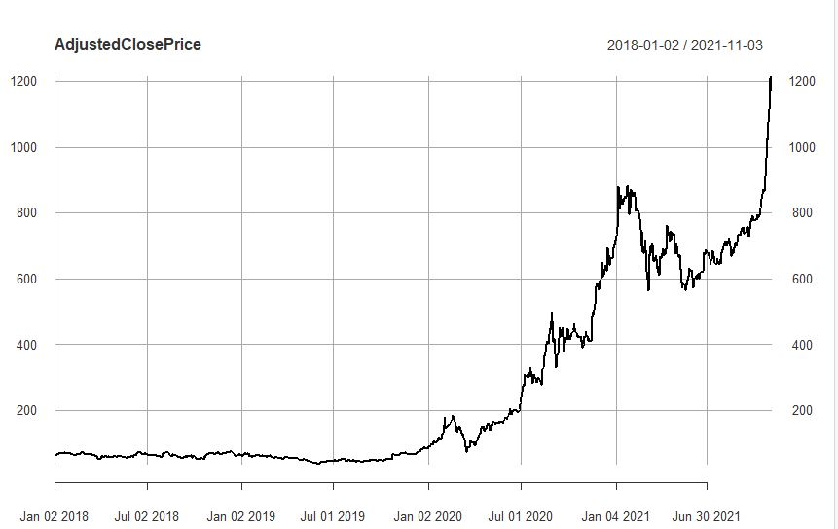
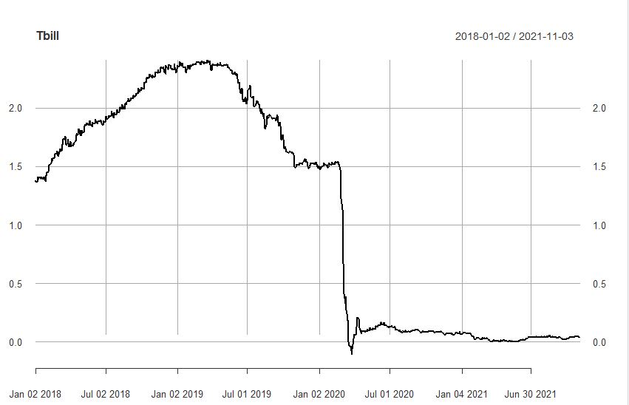
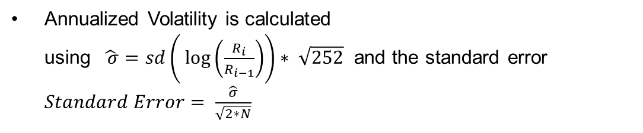
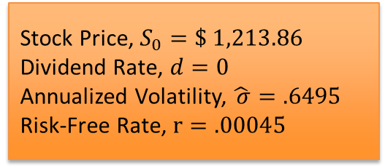
Market Parameters
Data Collection & Analysis
Below are the market parameters obtained from the downloaded TESLA stock and Treasury Bill data.
Stock Price, $S_{0}=\$ 1,213.86$
Dividend Rate, $d=0$
Annualized Volatility, $\hat{ σ}=.6495$
Risk-Free Rate, $r=.00045$
Last observed stock price of TESLA and treasury bill rate are considered from the downloaded data.
Annualized Volatility is calculated using $\hat{ σ}=sd\left( log\left(\frac{R_{i}}{R_{i−1}}\right)\right)∗ \sqrt{252}$ and the standard error $Standard Error= \frac{\hat{σ}}{\sqrt{2∗N}}$

Slide 5
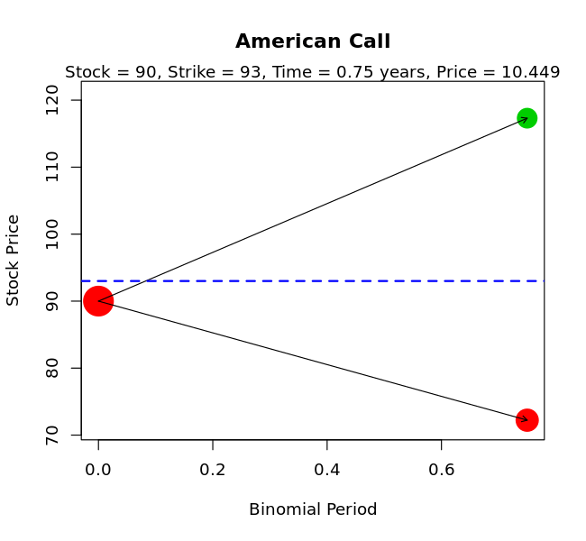
Binomial Tree
Model Development
Calculate the call & put price using the R library, derivmkts, by Robert McDonald (Ph.D.)
Dot size represents the probability of reaching each node
Dot color represents whether exercise occurs at that node
Blue dashed line represents the strike price (K)
Generates binomial tree pictured right
1. derivmkts::binomplot( s, k , v , r , t , d, n_steps,
2. putopt=FALSE,
3. american=TRUE,
4. plotarrows = TRUE,
5. drawstrike = FALSE )
Produces underlying data for binomial tree
1. derivmkts::binomopt( s, k , v , r , t , d, n_steps,
2. putopt=FALSE,
3. american=TRUE,
4. returntrees=TRUE)

Slide 6
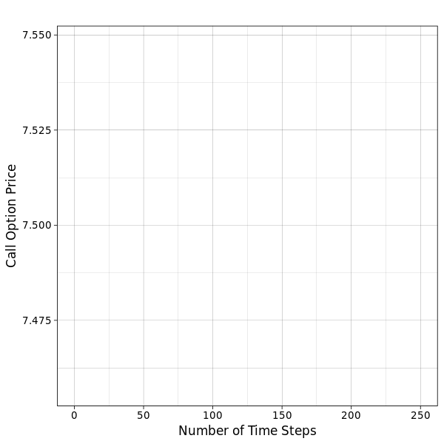
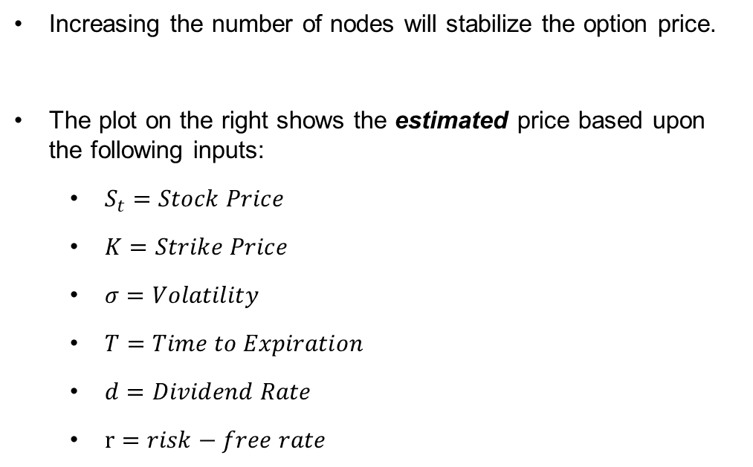
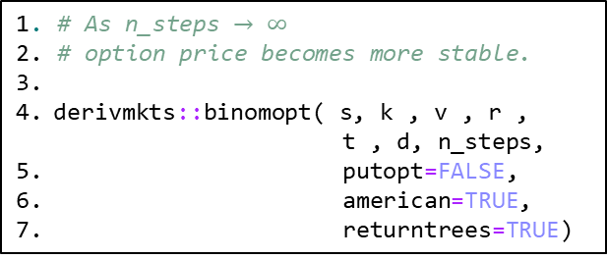
Binomial Tree
Model Development
Increasing the number of nodes will stabilize the option price.
The plot on the right shows the estimated price based upon the following inputs:
$S_{t}=Stock Price$
$K=Strike Price$
$σ=Volatility$
$T=Time to Expiration$
$d=Dividend Rate$
$r=risk−free rate$
1. # As n_steps $→ ∞$
2. # option price becomes more stable.
3.
derivmkts::binomopt( s, k , v , r ,
t , d, n_steps,
5. putopt=FALSE,
6. american=TRUE,
7. returntrees=TRUE)

Slide 7
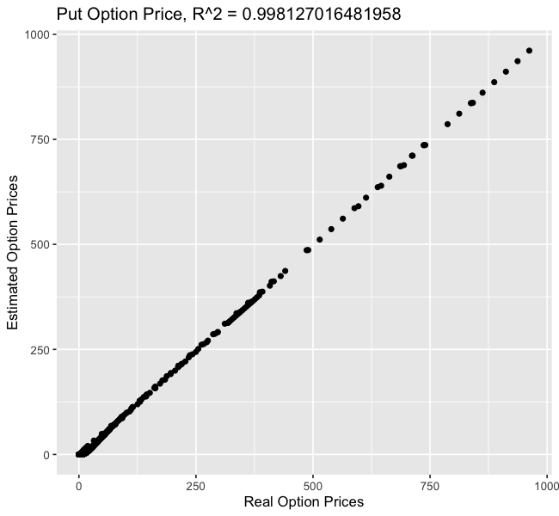
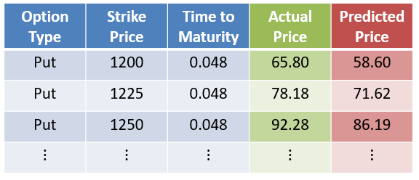
American Put Option
Model Deployment & Validation
The plot on the right shows the comparison on put option price
High value of R squared indicates fitted regression model
Blue ​cells represent the inputs to your model
Green Cells are the actual value
Red ​cells represent the final estimation.
The last two columns in the table are being plotted.

Slide 8
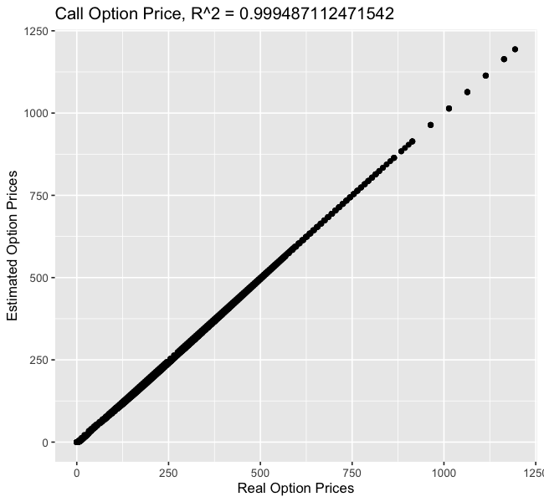
American Call Option
Model Deployment & Validation
Estimated the call & put price using the R library, derivmkts, by Robert McDonald (Ph.D.)
The plot on the right shows the comparison on call option price
High value of R squared indicates fitted regression model
#using same function on predicted values
derivmkts::binomopt( s, k , v , r , t , d, n_steps,
2. putopt=FALSE,
3. american=TRUE,
4. returntrees=TRUE)

Slide 9
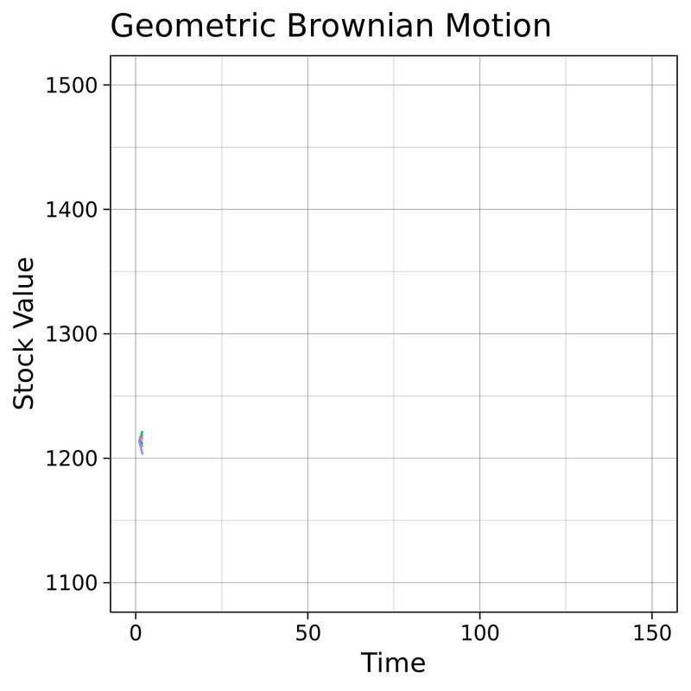
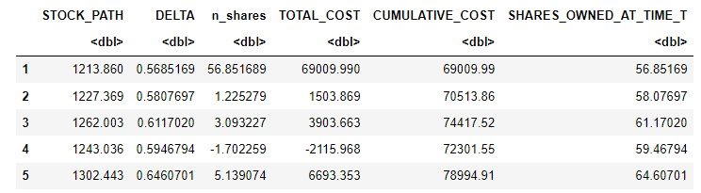
Delta Hedging
We generate stock paths using Geometric Brownian Motion (GBM). Next, Delta is calculated for every stock price. Based on this, we compute number of shares to purchase. The total cost of our hedging strategy is computed as well.

Slide 10
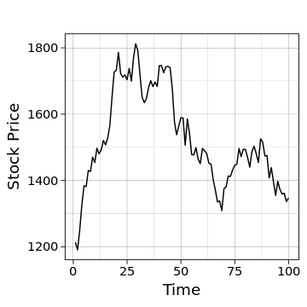
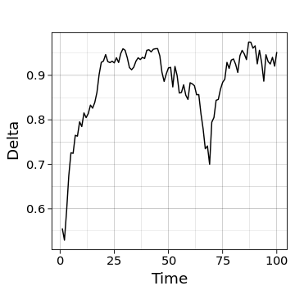
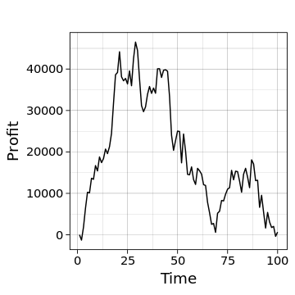
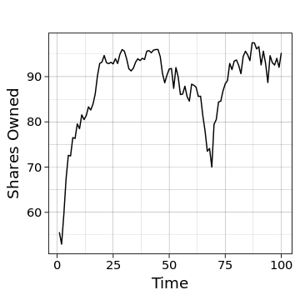
Delta Hedging
The graph on the right shows the following:
Top Left – Stock Price over time
Top Right – As Stock price increases, so does the delta.
Bottom Left – Delta determines how many shares to buy or sell
Bottom Right – Based upon the buying & selling of shares, the investor will incur a profit, or loss.

Slide 11

Thank You!

Slide 12
References
[1] J. Hull, Options, Futures and Other Derivatives, Pearson 10th Edition, 2018
[2] S. Shreve, Stochastic Calculus for Finance I: The Binomial Asset Pricing
Model, New York: Springer, 2004
[3] R. McDonald, Derivatives Markets, Pearson 3rd Edition, 2013

